Slide 1
Object Oriented Programming (OOPS)

Slide 2
Agenda
Data Hiding
2. Abstraction
3. Encapsulation
4. Tightly Encapsulated Class 5. IS-A Relationship(Inheritance) o Multiple inheritance o Cyclic inheritance
6. HAS-A Relationship o Composition o Aggregation
7. Method Signature
8. Polymorphism o Overloading ▪ Automatic promotion in overloading o Overriding ▪ Rules for overriding ▪ Checked Vs Un-checked Exceptions ▪ Overriding with respect to static methods ▪ Overriding with respect to Var-arg methods ▪ Overriding with respect to variables ▪ Differences between overloading and overriding ? o Method Hiding
9. Static Control Flow o Static control flow parent to child relationship o Static block
10. Instance Control Flow o Instance control flow in Parent to Child relationship
11. Constructors o Constructor Vs instance block o Rules to write constructors o Default constructor o Prototype of default constructor o super() vs this(): o Overloaded constructors o Recursive functions
12. Coupling
13. Cohesion
14. Object Type Casting o Compile time checking o Runtime checking
▪ Singleton classes
▪ Factory method

Slide 3
Data Hiding

Slide 4
• Our internal data should not go out directly that is outside person can't access our internal data directly.
• By using private modifier we can implement data hiding.
Example: class Account {
private double balance;
......................;
......................;
}
After providing proper username and password only , we can access our Account information.
The main advantage of data hiding is security. Note: recommended modifier for data members is private.

Slide 5
Abstraction

Slide 6
• Hide internal implementation and just highlight the set of services, is called
abstraction.
• By using abstract classes and interfaces we can implement abstraction.
2. Enhancement will become very easy because without effecting end user we can
able to perform any type of changes in our internal system.
3. It provides more flexibility to the end user to use system very easily.
4. It improves maintainability of the application.
5. It improves modularity of the application.
6. It improves easyness to use our system.
Example :
By using ATM GUI screen bank people are highlighting the set of services what they
are offering without highlighting internal implementation.
The main advantages of Abstraction are:
By using interfaces (GUI screens) we can implement abstraction
1. We can achieve security as we are not highlighting our internal implementation.(i.e., outside person doesn't aware our internal implementation.)
175

Slide 7
Encapsulation

Slide 8
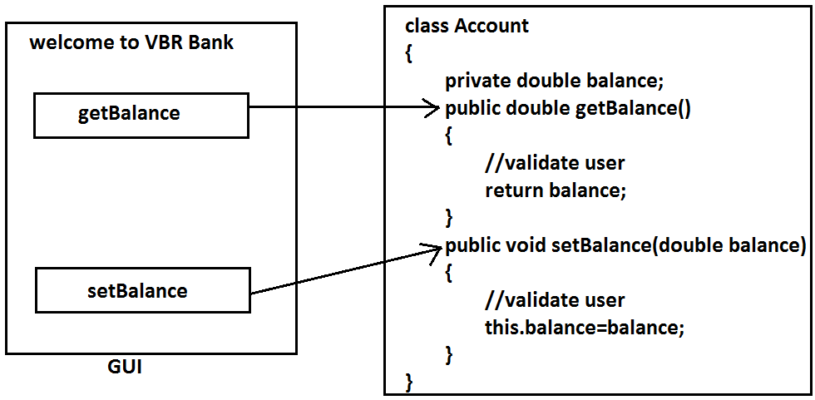
• Binding of data and corresponding methods into a single unit is called
Encapsulation .
• If any java class follows data hiding and abstraction such type of class is said to
be encapsulated class.
Every data member should be declared as private and for every member we have to
maintain getter & Setter methods.
The main advantages of encapsulation are :
1. We can achieve security.
2. Enhancement will become very easy.
3. It improves maintainability and modularity of the application.
4. It provides flexibility to the user to use system very easily.
Encapsulation=Datahiding+Abstraction
The main disadvantage of encapsulation is it increases length of the code and slows
down execution.
176

Slide 9
Tightly encapsulated class

Slide 10
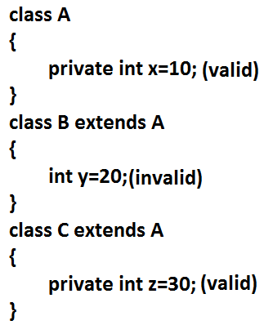
A class is said to be tightly encapsulated if and only if every variable of that class
declared as private. whether the variable has getter and setter methods or not , and
whether these methods declared as public or not, these checkings are not required to
perform.
Which of the following classes are tightly encapsulated?
Example:
class Account {
private double balance;
public double getBalance() {
return balance;
}
}

Slide 11
Which of the following classes are tightly encapsulated?
class A {
int x=10; //not
}
class B extends A {
private int y=20; //not
}
class C extends B {
private int z=30; //not
}
Note: if the parent class is not tightly encapsulated then no child class is tightly
encapsulated.
177

Slide 12
IS-A Relationship(inheritance)

Slide 13
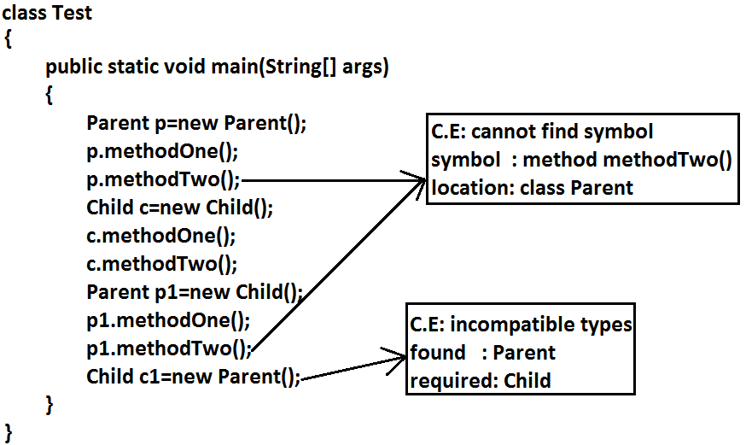
1. Also known as inheritance.
2. By using "extends" keywords we can implement IS-A relationship.
3. The main advantage of IS-A relationship is reusability.
Example:
class Parent {
public void methodOne(){ }
}
class Child extends Parent {
public void methodTwo() { }
}.
178

Slide 14
Conclusion :
1. Whatever the parent has by default available to the child but whatever the child
has by default not available to the parent. Hence on the child reference we can
call both parent and child class methods. But on the parent reference we can call
only methods available in the parent class and we can't call child specific
methods.
2. Parent class reference can be used to hold child class object, but by using that
reference ,we can call only methods available in parent class and child specific
methods we can't call.
3. Child class reference cannot be used to hold parent class object.
Example:
The common methods which are required for housing loan, vehicle loan, personal loan
and education loan we can define into a separate class in parent class loan. So that
automatically these methods are available to every child loan class.
Example:
class Loan {
//common methods which are required for any type of loan.
}
class HousingLoan extends Loan {
//Housing loan specific methods.
}
class EducationLoan extends Loan {
//Education Loan specific methods.
}
178

Slide 15
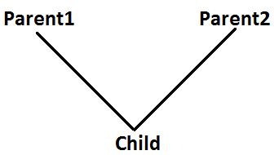
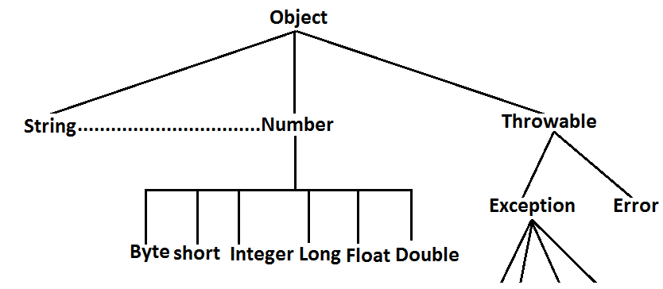
• For all java classes the most commonly required functionality is define inside
object class hence object class acts as a root for all java classes.
• For all java exceptions and errors the most common required functionality
defines inside Throwable class hence Throwable class acts as a root for exception
hierarchy.
Multiple inheritance
Having more than one Parent class at the same level is called multiple inheritance.
179

Slide 16
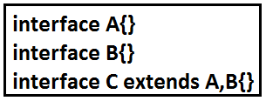
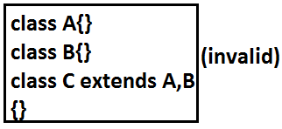
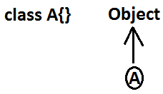
Any class can extends only one class at a time and can't extends more than one class simultaneously hence java won't provide support for multiple inheritance
But an interface can extends any no. Of interfaces at a time hence java provides support
for multiple inheritance through interfaces.
If our class doesn't extends any other class then only our class is the direct child class of
object.
180

Slide 17
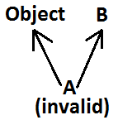
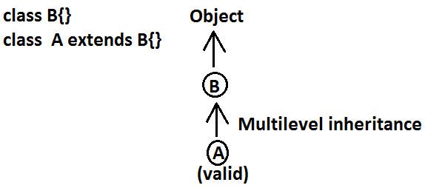
If our class extends any other class then our class is not direct child class of object, It is indirect child class of object , which forms multilevel inheritance.
Example 2:
Why java won't provide support for multiple inheritance?
There may be a chance of raising ambiguity problems
181

Slide 18
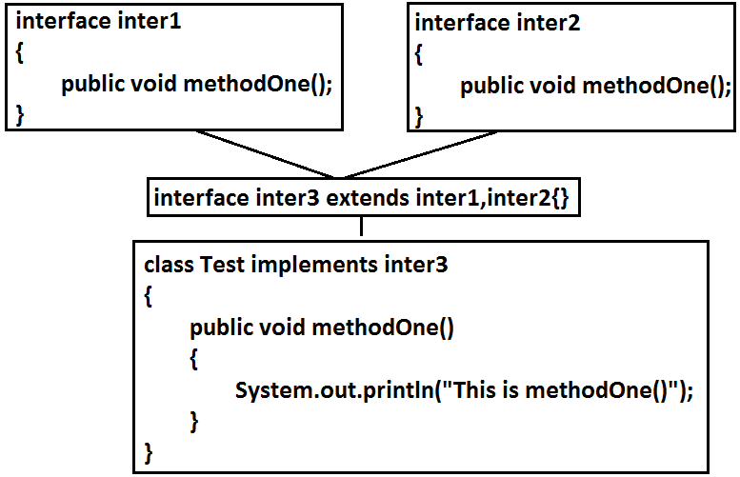
Example:
182

Slide 19

Cyclic inheritance

Slide 20
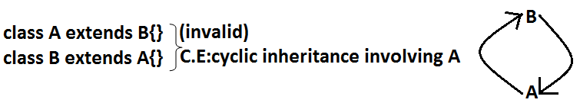
Cyclic inheritance is not allowed in java.
Example 1:
Example 2:

Slide 21
HAS-A relationship

Slide 22
• class Car HAS-A engine reference.
• The main dis-advantage of HAS-A relationship increases dependency between
the components and creates maintainance problems.
1. HAS-A relationship is also known as composition (or) aggregation.
2. There is no specific keyword to implement HAS-A relationship but mostly we
can use new operator.
3. The main advantage of HAS-A relationship is reusability
Composition vs Aggregation
Composition:
Without existing container object if there is no chance of existing contained objects then
the relationship between container object and contained object is called composition
which is a strong association.
Example:
class Engine
{
//engine specific functionality
}
class Car
{
Engine e=new Engine();
//........................;
//........................;
//........................;
}
183

Slide 23
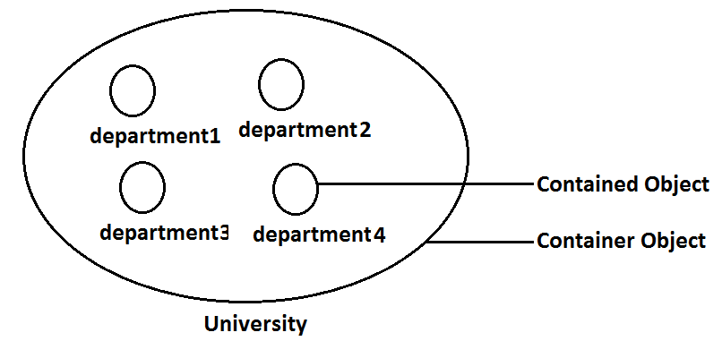
Example:
University consists of several departments whenever university object destroys
automatically all the department objects will be destroyed that is without existing
university object there is no chance of existing dependent object hence these are
strongly associated and this relationship is called composition
Aggregation :
Without existing container object if there is a chance of existing contained objects such
type of relationship is called aggregation. In aggregation objects have weak association.
Example:
Within a department there may be a chance of several professors will work whenever
we are closing department still there may be a chance of existing professor object
without existing department object the relationship between department and professor
is called aggregation where the objects having weak association.
Example:
184

Slide 24
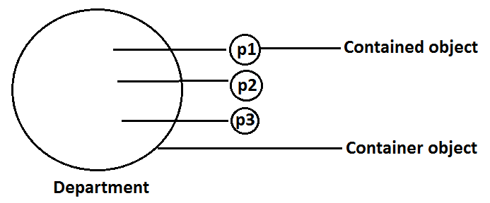
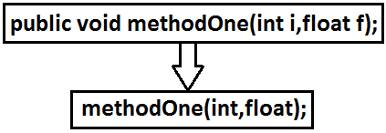
Example:
Method signature:
In java, method signature consists of name of the method followed by argument types.
Note :
In composition container , contained objects are strongly associated, and but container
object holds contained objects directly
But in Aggregation container and contained objects are weakly associated and
container object just now holds the reference of contained objects
• In java return type is not part of the method signature.
• Compiler will use method signature while resolving method calls.
185

Slide 25
class Test {
public void m1(double d) { }
public void m2(int i) { }
public static void main(String ar[]) {
Test t=new Test();
t.m1(10.5);
t.m2(10);
t.m3(10.5); //CE
}
}
CE : cannot find symbol
symbol : method m3(double)
location : class Test
Within the same class we can't take 2 methods with the same signature otherwise we will get compile time error.
Example:
public void methodOne() { }
public int methodOne() {
return 10;
}
Output:
Compile time error
methodOne() is already defined in Test
185

Slide 26
Polymorphism

Slide 27
Same name with different forms is the concept of polymorphism.
Example 1: We can use same abs() method for int type, long type, float type etc.
Example:
1. abs(int)
2. abs(long)
3. abs(float)
Example:
1. List l=new ArrayList();
2. List l=new LinkedList();
3. List l=new Vector();
4. List l=new Stack();
Example 2:
We can use the parent reference to hold any child objects.
We can use the same List reference to hold ArrayList object, LinkedList object, Vector
object, or Stack object.
186

Slide 28
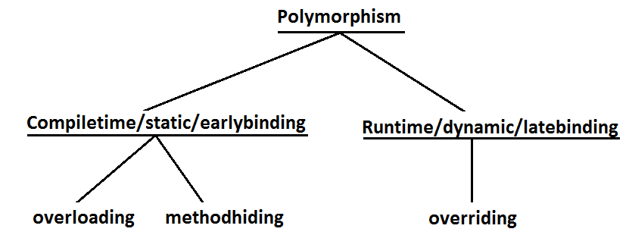
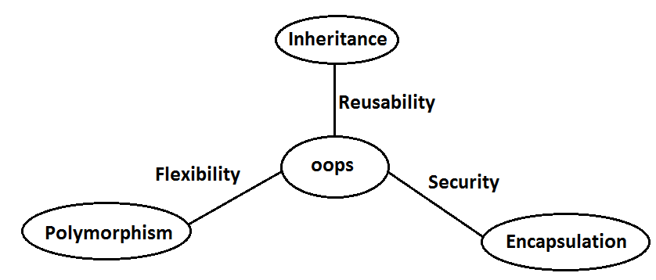
Diagram:
Diagram: 3 Pillars of OOPS
1) Inheritance talks about reusability.
2) Polymorphism talks about flexibility.
3) Encapsulation talks about security.

Slide 29
Beautiful definition of polymorphism:
A boy starts love with the word friendship, but girl ends love with the same word friendship, word is the same but with different attitudes. This concept is nothing but polymorphism.
187

Slide 30
Overloading

Slide 31
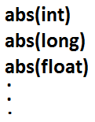
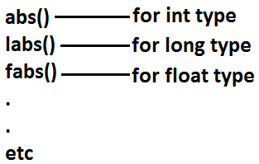
3. Lack of overloading in "C" increases complexity of the programming.
4. But in java we can take multiple methods with the same name and different argument types.
Example:
1. Two methods are said to be overload if and only if both having the same name but different argument types
2. In 'C' language we can't take 2 methods with the same name and different types.
If there is a change in argument type compulsory we should go for new method name.
5. Having the same name and different argument types is called method
overloading.
6. All these methods are considered as overloaded methods.
7. Having overloading concept in java reduces complexity of the programming.
187

Slide 32
Example:
class Test {
public void methodOne() {
System.out.println("no-arg method");
}
public void methodOne(int i) {
System.out.println("int-arg method"); //overloaded methods
}
public void methodOne(double d) {
System.out.println("double-arg method");
}
public static void main(String[] args) {
Test t=new Test();
t.methodOne();//no-arg method
t.methodOne(10);//int-arg method
t.methodOne(10.5);//double-arg method
}
}
Conclusion :
In overloading compiler is responsible to perform method
resolution(decision) based on the reference type(but not based on run time object). Hence overloading is also considered as compile time polymorphism(or) static polymorphism (or)early biding
188

Slide 33
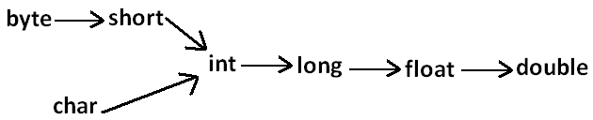
Case 1:
Automatic promotion in overloading.
• In overloading if compiler is unable to find the method with exact match we won't get any compile time error immediately.
• 1st compiler promotes the argument to the next level and checks whether the matched method is available or not if it is available then that method will be considered if it is not available then compiler promotes the argument once again to the next level. This process will be continued until all possible promotions still if the matched method is not available then we will get compile time error. This
process is called automatic promotion in overloading.
The following are various possible automatic promotions in overloading
189

Slide 34
Example:
class Test
{
public void methodOne(int i)
{
System.out.println("int-arg method");
}
public void methodOne(float f) //overloaded methods
{
System.out.println("float-arg method");
}
public static void main(String[] args)
{
Test t=new Test();
//t.methodOne('a');//int-arg method
//t.methodOne(10l);//float-arg method
t.methodOne(10.5);//C.E:cannot find symbol
}
}
Case 2:
class Test
{
public void methodOne(String s)
{
System.out.println("String version");
}
public void methodOne(Object o) //Both methods are said to
//be
overloaded methods.
{
System.out.println("Object version");
}
public static void main(String[] args)
{
Test t=new Test();
t.methodOne("arun");//String version
t.methodOne(new Object());//Object version
t.methodOne(null);//String version
}
}
189

Slide 35
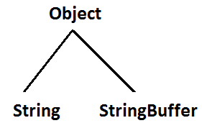
Note :
While resolving overloaded methods exact match will always get high priority,
While resolving overloaded methods child class will get the more priority than parent class
Output:
Case 3:
class Test{
public void methodOne(String s) {
System.out.println("String version");
}
public void methodOne(StringBuffer s) {
System.out.println("StringBuffer version");
}
public static void main(String[] args) {
Test t=new Test();
t.methodOne("arun");//String version
t.methodOne(new StringBuffer("sai"));//StringBuffer version
t.methodOne(null);//CE : reference to m1() is ambiquous
}
}
Case 4:
class Test {
public void methodOne(int i,float f) {
System.out.println("int-float method");
}
public void methodOne(float f,int i) {
System.out.println("float-int method");
}
public static void main(String[] args) {
190

Slide 36
Test t=new Test();
t.methodOne(10,10.5f);//int-float method
t.methodOne(10.5f,10);//float-int method
t.methodOne(10,10); //C.E:
//CE:reference to methodOne is ambiguous,
//both method methodOne(int,float) in Test
//and method methodOne(float,int) in Test match
t.methodOne(10.5f,10.5f);//C.E:
cannot find symbol
symbol : methodOne(float, float)
location : class Test
}
}
Case 5 :
class Test{
public void methodOne(int i) {
System.out.println("general method");
}
public void methodOne(int...i) {
System.out.println("var-arg method");
}
public static void main(String[] args) {
Test t=new Test();
t.methodOne();//var-arg method
t.methodOne(10,20);//var-arg method
t.methodOne(10);//general method
}
}

Slide 37
In general var-arg method will get less priority ie if no other method matched then only var-arg method will get chance for execution it is almost same as default case inside switch.
Monkey m=new Monkey();
t.methodOne(m);//Monkey version
Animal a1=new Monkey();
t.methodOne(a1);//Animal version
}
}
Case 6:
class Animal{ }
class Monkey extends Animal{}
class Test{
public void methodOne(Animal a) {
System.out.println("Animal version");
}
public void methodOne(Monkey m) {
System.out.println("Monkey version");
}
public static void main(String[] args) {
Test t=new Test();
Animal a=new Animal();
t.methodOne(a);//Animal version
In overloading method resolution is always based on reference type and runtime object won't play any role in overloading.
191

Slide 38
Overriding

Slide 39
method
}
}
class Child extends Parent{ //overriding
public void marry() {
System.out.println("3sha/4me/9tara/anushka");
//overriding method
}
}
class Test {
public static void main(String[] args) {
Parent p=new Parent();
p.marry();//subbalakshmi(parent method)
Child c=new Child();
c.marry();//Trisha/nayanatara/anushka(child method)
Parent p1=new Child();
p1.marry();//Trisha/nayanatara/anushka(child method)
}
}
1. Whatever the Parent has by default available to the Child through inheritance, if
the Child is not satisfied with Parent class method implementation then Child is allow to redefine that Parent class method in Child class in its own way this process is called overriding.
2. The Parent class method which is overridden is called overridden method.
3. The Child class method which is overriding is called overriding method.
Example 1:
class Parent {
public void property(){
System.out.println("cash+land+gold");
}
public void marry() {
System.out.println("subbalakshmi"); //overridden
192

Slide 40
According to this Child class method return type need not be same as Parent
class method return type its Child types also allowed.
In overriding method resolution is always takes care by JVM based on runtime object hence overriding is also considered as runtime polymorphism or dynamic
polymorphism or late binding.
The process of overriding method resolution is also known as dynamic method dispatch.
Example:
class Parent {
public Object methodOne() {
return null;
}
}
class Child extends Parent {
public String methodOne() {
return null;
}
}
C:> javac -source 1.4 Parent.java //error
It is valid in "1.5" but invalid in "1.4".
Diagram:
Note: In overriding runtime object will play the role and reference type is dummy.
Rules for overriding
In overriding method names and arguments must be same. That is method signature must be same.
Until 1.4 version the return types must be same but from 1.5 version onwards covariant return types are allowed.
192

Slide 41
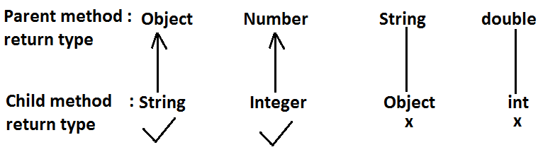
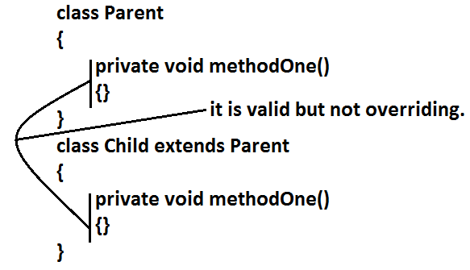
Example
Co-variant return type concept is applicable only for object types but not for primitives.
Private methods are not visible in the Child classes hence overriding concept is not applicable for private methods. Based on own requirement we can declare the same Parent class private method in child class also. It is valid but not
overriding.
193

Slide 42
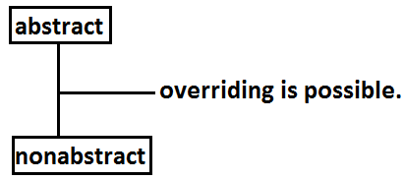
We should override Parent class abstract methods in Child classes to provide
implementation.
Example:
abstract class Parent {
public abstract void methodOne();
}
class Child extends Parent {
public void methodOne() { }
}
Parent class final methods we can't override in the Child class.
Example:
class Parent {
public final void methodOne() {}
}
class Child extends Parent{
public void methodOne(){}
}
Output:
Compile time error:
methodOne() in Child cannot override methodOne()
in Parent; overridden method is final
Parent class non final methods we can override as final in child class. We can override native methods in the child classes.
194

Slide 43
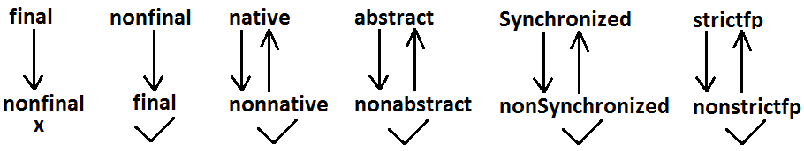
We can override a non-abstract method as abstract
this approach is helpful to stop availability of Parent method implementation to the next level child classes.
Example:
class Parent {
public void methodOne() { }
}
abstract class Child extends Parent {
public abstract void methodOne();
}
While overriding we can't reduce the scope of access modifier
Example:
class Parent {
public void methodOne() { }
}
class Child extends Parent {
protected void methodOne( ) { }
}
Synchronized, strictfp, modifiers won't keep any restrictions on overriding
Output:
Compile time error :
methodOne() in Child cannot override methodOne() in Parent;
attempting to assign weaker access privileges; was public
195

Slide 44
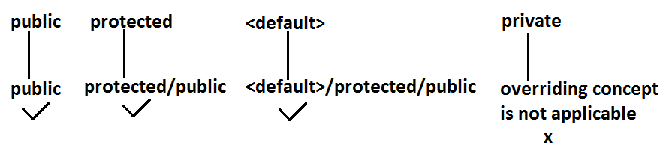
private < default < protected < public
196

Slide 45
Checked Vs Un-checked Exceptions

Slide 46
• The exceptions which are checked by the compiler for smooth execution of the
program at runtime are called checked exceptions.
• The exceptions which are not checked by the compiler are called un-checked
exceptions.
• RuntimeException and its child classes, Error and its child classes are unchecked
except these the remaining are checked exceptions.
196

Slide 47
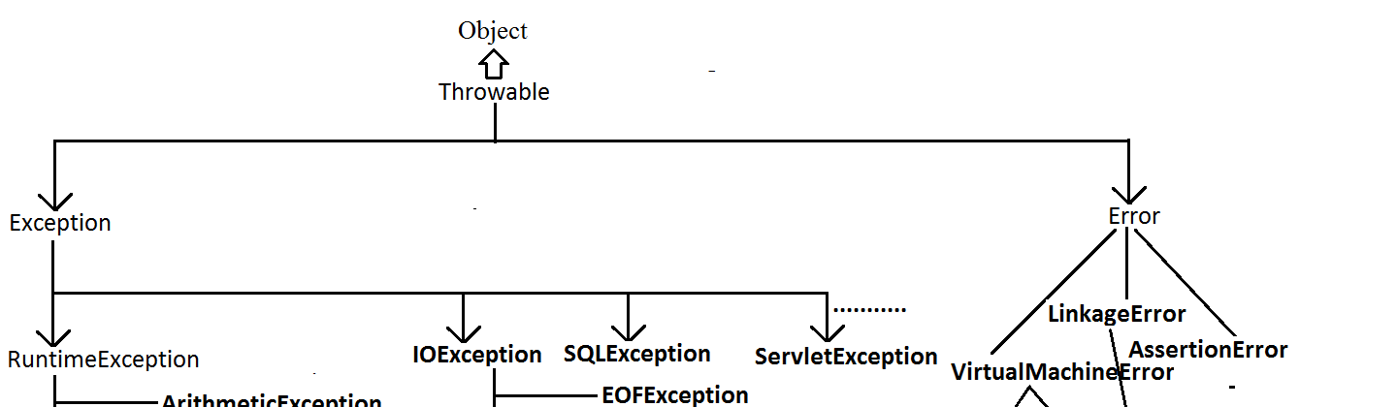
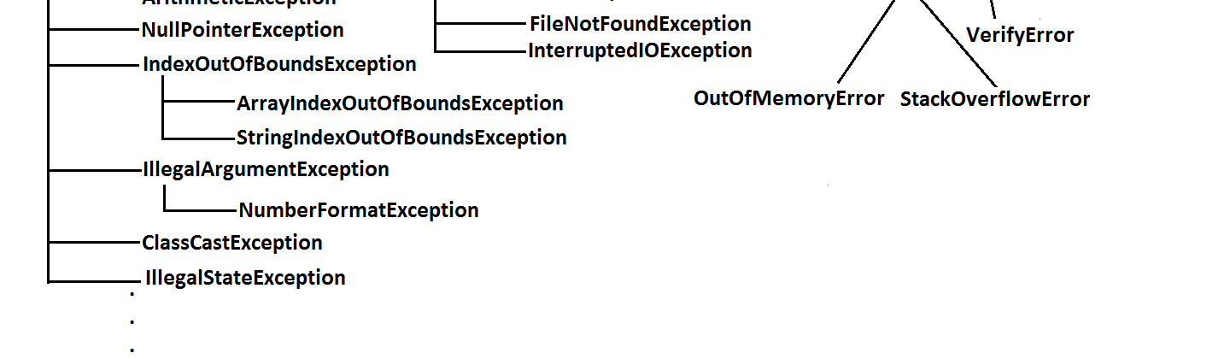
Rule: While overriding if the child class method throws any checked exception compulsory the parent class method should throw the same checked exception or its parent otherwise we will get compile time error.
197

Slide 48
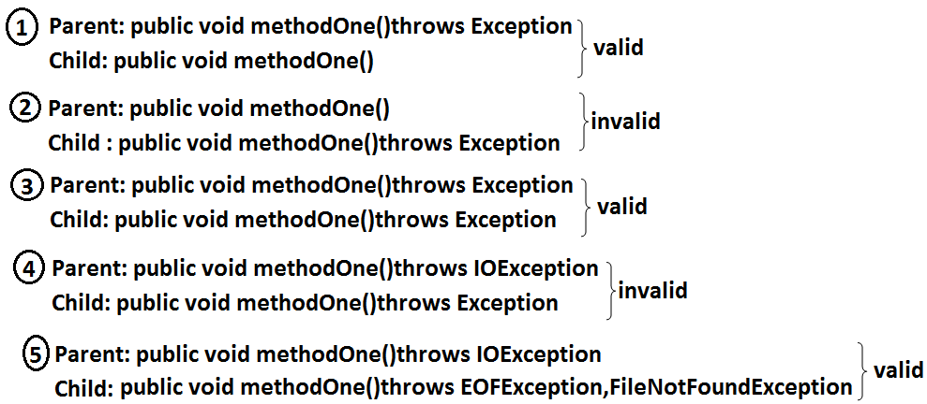
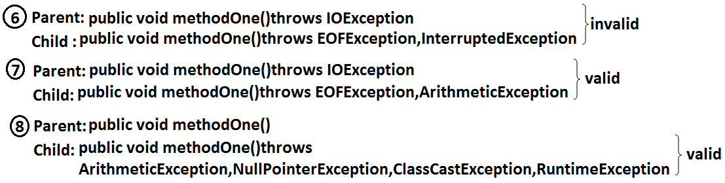
But there are no restrictions for un-checked exceptions
Example:
class Parent {
public void methodOne() {}
}
class Child extends Parent{
public void methodOne()throws Exception {}
}
Output:
Compile time error :
methodOne() in Child cannot override methodOne() in Parent;
overridden method does not throw java.lang.Exception
197

Slide 49
Case 2:
Overriding with respect to static methods
Similarly we can't override a non static method as static.
Case 3:
class Parent
{
public static void methodOne() {}
}
class Child extends Parent {
public static void methodOne() {}
}
Case 1:
We can't override a static method as non static.
Example:
class Parent
{
public static void methodOne(){}
//here static methodOne() method is a class level
}
class Child extends Parent
{
public void methodOne(){}
//here methodOne() method is a object level hence
// we can't override methodOne() method
}
output :
CE: methodOne in Child can't override methodOne() in Parent ;
overriden method is static
It is valid. It seems to be overriding concept is applicable for static methods, but it is not
overriding it is method hiding.

Slide 50
METHOD HIDING

Slide 51
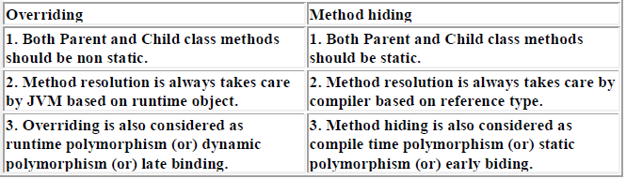
All rules of method hiding are exactly same as overriding except the following differences.
199

Slide 52
Example:
class Parent {
public static void methodOne() {
System.out.println("parent class");
}
}
class Child extends Parent{
public static void methodOne(){
System.out.println("child class");
}
}
class Test{
public static void main(String[] args) {
Parent p=new Parent();
p.methodOne();//parent class
Child c=new Child();
c.methodOne();//child class
Parent p1=new Child();
p1.methodOne();//parent class
}
}
Note: If both Parent and Child class methods are non static then it will become overriding and method resolution is based on runtime object. In this case the output is
Parent class
Child class
Child class
Overriding with respect to Var-arg methods:
A var-arg method should be overridden with var-arg method only. If we are trying to override with normal method then it will become overloading but not overriding.
199

Slide 53
Example:
class Parent {
public void methodOne(int... i){
System.out.println("parent class");
}
}
class Child extends Parent { //overloading but not overriding.
public void methodOne(int i) {
System.out.println("child class");
}
}
class Test {
public static void main(String[] args) {
Parent p=new Parent();
p.methodOne(10);//parent class
Child c=new Child();
c.methodOne(10);//child class
Parent p1=new Child();
p1.methodOne(10);//parent class
}
}
In the above program if we replace child class method with var arg then it will become
overriding. In this case the output is
Parent class
Child class
Child class
Overriding with respect to variables:
• Overriding concept is not applicable for variables.
• Variable resolution is always takes care by compiler based on reference type.
200

Slide 54
Example:
class Parent
{
int x=888;
}
class Child extends Parent
{
int x=999;
}
class Test
{
public static void main(String[] args)
{
Parent p=new Parent();
System.out.println(p.x);//888
Child c=new Child();
System.out.println(c.x);//999
Parent p1=new Child();
System.out.println(p1.x);//888
}
}
Note: In the above program Parent and Child class variables, whether both are static or non static whether one is static and the other one is non static there is no change in the answer.
200

Slide 55
Differences between overloading and overriding ?
2) Argument type | Must be different(at least order) | Must be same including order
3) Method signature | Must be different | Must be same.
4) Return types | No restrictions. | Must be same until 1.4v but from 1.5v onwards we can take co-variant return types also.
5) private,static, final methods | Can be overloaded | Can not be overridden.
6) Access modifiers | No restrictions. | Weakering/reducing is not allowed.
7) Throws clause | No restrictions | If child class method throws any checked exception compulsory parent class method should throw the same checked exceptions or its parent but no restrictions for un-checked exceptions.
8) Method resolution | Is always takes care by compiler based on referenced type. | Is always takes care by JVM based on runtime object.
9) Also known as | Compile time polymorphism (or) static(or)early binding. | Runtime polymorphism (or) dynamic (or) late binding.
Property | Overloading | Overriding
1) Method names | Must be same. | Must be same.

Slide 56
Note:
1. In overloading we have to check only method names (must be same) and arguments (must be different) the remaining things like return type extra not required to check.
In the child class which of the following methods we can take..
1. public void methodOne(int i)//valid(overriding)
2. private void methodOne()throws Exception//valid(overloading)
3. public native void methodOne(int i);//valid(overriding)
4. public static void methodOne(double d)//valid(overloading)
5. public static void methodOne(int i)
Compile time error :
2. But In overriding we should compulsory check everything like method names,
arguments, return types, throws keyword, modifiers etc.
Consider the method in parent class
Parent: public void methodOne(int i)throws IOException
methodOne(int) in Child cannot override methodOne(int) in Parent; overriding
method is static
201

Slide 57
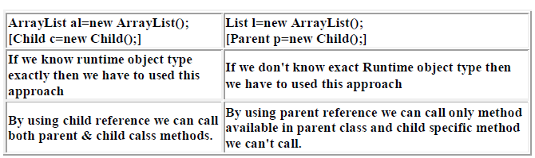
public static abstract void methodOne(float f)
Compile time error :
1. illegal combination of modifiers: abstract and static
2. Child is not abstract and does not override abstract method
methodOne(float) in Child
What is the difference between ArrayList l=new ArrayList() & List l=new ArrayList() ?
202

Slide 58
• We can use ArrayList reference to hold ArrayList object where as we can use
List reference to hold any list implemented class object (ArrayList, LinkedList,
Vector, Stack)
• By using ArrayList reference we can call both List and ArrayList methods but
by using List reference we can call only List interface specific methods and we
can't call ArrayList specific methods.
By using Clone() :
Test t1 = new Test();
Test t2 = (Test)t1.Clone();
By using Factory methods :
Runtime r = Runtime.getRuntime();
DateFormat df = DateFormat.getInstance();
By using Deserialization :
FileInputStream fis = new FileInputStream("abc.ser");
ObjectInputStream ois = new ObjectInputStream(fis);
Test t = (Test)ois.readObject();
IIQ : In how many ways we can create an object ? (or) In
how many ways get an object in java ?
By using new Operator :
Test t = new Test();
By using newInstance() :(Reflection Mechanism)
Test t=(Test)Class.forName("Test").newInstance();
202

Slide 59
Constructors

Slide 60
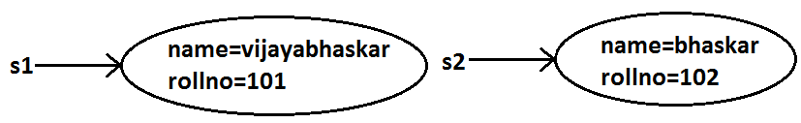
this.name=name;
this.rollno=rollno;
}
public static void main(String[] args)
{
Student s1=new Student("vijayabhaskar",101);
Student s2=new Student("bhaskar",102);
}
}
1.Creation of Object is not enough. Sometimes we should perform initialization.Then only the object is in a position to provide the response properly.
2. Whenever we are creating an object some piece of the code will be executed automatically to perform initialization of an object. This piece of the code is nothing but constructor.
3. Hence the main objective of constructor is to perform initialization of an object.
Example:
class Student
{
String name;
int rollno;
Student(String name,int rollno) //Constructor
{
203

Slide 61
Demo program to track no of objects created for a class:
class Test
{
static int count=0;
{
count++; //instance block
}
Test()
{}
Test(int i)
{}
public static void main(String[] args)
{
Test t1=new Test();
Test t2=new Test(10);
Test t3=new Test();
System.out.println(count);//3
}
}
Constructor Vs instance block:
1. Both instance block and constructor will be executed automatically for every
object creation but instance block 1st followed by constructor.
2. The main objective of constructor is to perform initialization of an object.
3. Other than initialization if we want to perform any activity for every object
creation we have to define that activity inside instance block.
4. Both concepts having different purposes hence replacing one concept with
another concept is not possible.
5. Constructor can take arguments but instance block can't take any arguments
hence we can't replace constructor concept with instance block.
6. Similarly we can't replace instance block purpose with constructor.
204

Slide 62
It is legal (but stupid) to have a method whose name is exactly same as class
name.
The only applicable modifiers for the constructors are public, default, private,
protected.
If we are using any other modifier we will get compile time error.
Rules to write constructors
Name of the constructor and name of the class must be same.
Return type concept is not applicable for constructor, even void also. By mistake if we are declaring the return type for the constructor we won't get any compile time error or runtime error, compiler simply treats it as a method
Example:
class Test
{
static Test()
{}
}
Output:
Modifier static not allowed here
Example:
class Test
{
void Test() //it is not a constructor and it is a method
{}
}
204

Slide 63
Default constructor
Prototype of default constructor:
It is always no argument constructor.
The access modifier of the default constructor is same as class modifier. (This
rule is applicable only for public and default).
Default constructor contains only one line. super(); it is a no argument call to super class constructor.
For every class in java including abstract classes also constructor concept is
applicable.
If we are not writing at least one constructor then compiler will generate default
constructor.
If we are writing at least one constructor then compiler won't generate any
default constructor. Hence every class contains either compiler generated constructor (or) programmer written constructor but not both simultaneously
205

Slide 64
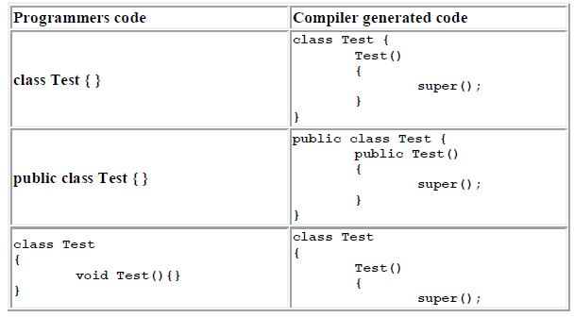
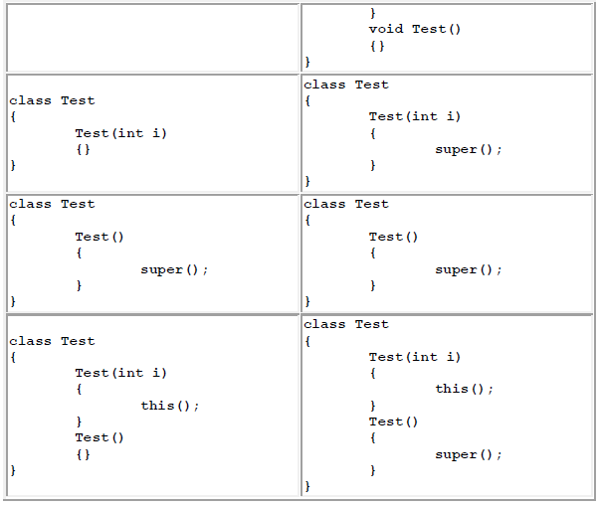
205

Slide 65
super() vs this()

Slide 66
The 1st line inside every constructor should be either super() or this() if we are not writing anything compiler will always generate super().
Case 2: We can use either super() (or) this() but not both simultaneously.
Example:
class Test
{
Test()
{
super();
this();
}
}
Case 1: We have to take super() (or) this() only in the 1st line of constructor. If we are taking anywhere else we will get compile time error.
Example:
class Test
{
Test()
{
System.out.println("constructor");
super();
}
}
Output:
Compile time error.
Call to super must be first statement in constructor
Output:
Compile time error.
Call to this must be first statement in constructor
206

Slide 67
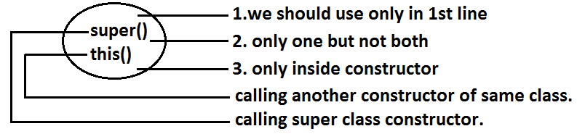
Case 3: We can use super() (or) this() only inside constructor. If we are using anywhere
else we will get compile time error.
Example:
class Test
{
public void methodOne()
{
super();
}
}
Output:
Compile time error.
Call to super must be first statement in constructor
That is we can call a constructor directly from another constructor only.
Diagram:
207

Slide 68
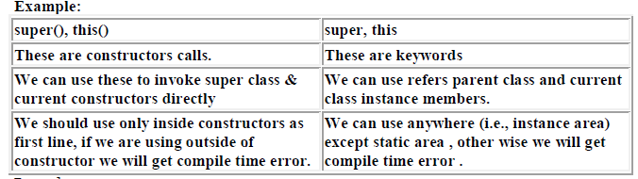
Example:
class Test
{
public static void main(String[] args)
{
System.out.println(super.hashCode());
}
}
.
Output:
Compile time error.
Non-static variable super cannot be referenced from a static context
207

Slide 69
Overloaded constructors :
A class can contain more than one constructor and all these constructors having the same name but different arguments and hence these constructors are considered as overloaded constructors.
//constructor/double-argument constructor
Test t2=new Test(10);
//int-argument constructor/double-argument constructor
Test t3=new Test(10.5);//double-argument constructor
}
}
Example:
class Test {
Test(double d){
System.out.println("double-argument constructor");
}
Test(int i) {
this(10.5);
System.out.println("int-argument constructor");
}
Test() {
this(10);
System.out.println("no-argument constructor");
}
public static void main(String[] args) {
Test t1=new Test(); //no-argument constructor/int-argument
Parent class constructor by default won't available to the Child. Hence
Inheritance concept is not applicable for constructors and hence overriding
concept also not applicable to the constructors. But constructors can be
overloaded.
We can take constructor in any java class including abstract class also but we can't take constructor inside interface.
208

Slide 70
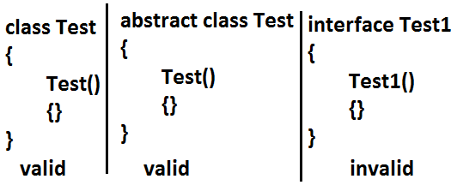
Which of the following statement is true ?
1. Whenever we are creating child class object then automatically parent class
object will be created.(false)
2. Whenever we are creating child class object then parent class constructor will be
executed.(true)
We can't create object for abstract class but abstract class can contain constructor what
is the need ?
Abstract class constructor will be executed for every child class object creation to perform initialization of child class object only.
208

Slide 71
class Test
{
public static void main(String[] args)
{
Child c=new Child();
System.out.println(c.hashCode());//11394033
}
}
Example:
abstract class Parent
{
Parent()
{
System.out.println(this.hashCode());
//11394033//here this means child class object
}
}
class Child extends Parent
{
Child()
{
System.out.println(this.hashCode());//11394033
}
}
Case 1: recursive method call is always runtime exception where as recursive
constructor invocation is a compile time error.
Note:
Recursive functions:
A function is called using two methods (types).
1. Nested call
2. Recursive call
209

Slide 72
Nested call:
• Calling a function inside another function is called nested call.
• In nested call there is a calling function which calls another function(called function).
Recursive call:
• Calling a function within same function is called recursive call.
• In recursive call called and calling function is same.
Example:
public static void methodOne()
{
methodTwo();
}
public static void methodTwo()
{
methodOne();
}
Example:
public void methodOne()
{
methodOne();
}

Slide 73
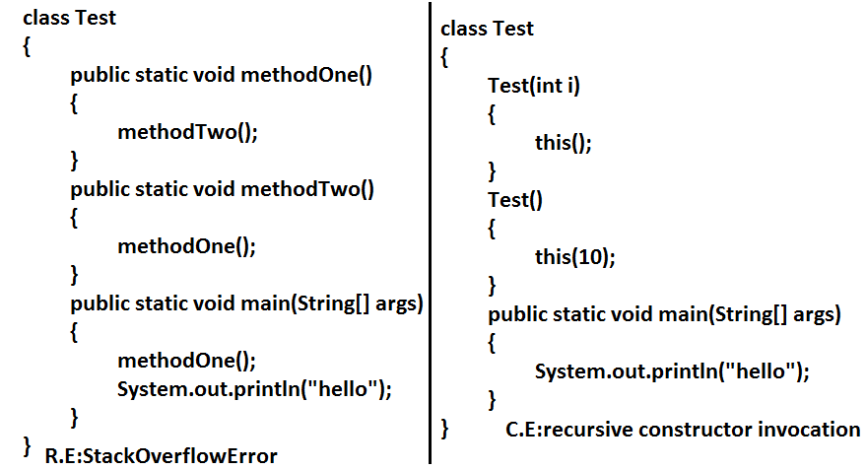
210

Slide 74
Note: Compiler is responsible for the following checkings.
1. Compiler will check whether the programmer wrote any constructor or not. If
he didn't write at least one constructor then compiler will generate default
constructor.
2. If the programmer wrote any constructor then compiler will check whether he
wrote super() or this() in the 1st line or not. If his not writing any of these
compiler will always write (generate) super().
3. Compiler will check is there any chance of recursive constructor invocation. If
there is a possibility then compiler will raise compile time error.

Slide 75
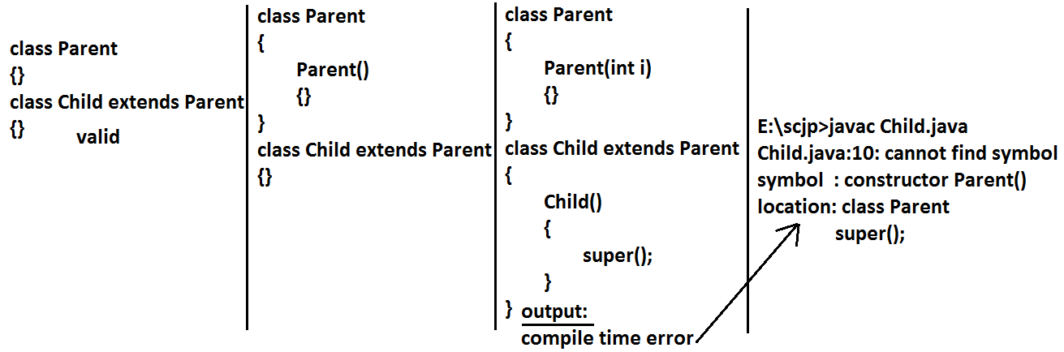
If the Parent class contains any argument constructors while writing Child classes we should takes special care with respect to constructors.
• Whenever we are writing any argument constructor it is highly recommended to write no argument constructor also.
211

Slide 76
Example:
class Parent
{
Parent()throws java.io.IOException
{}
}
class Child extends Parent
{
Child()throws Exception
{
super();
}
}
Case 3:
class Parent
{
Parent()throws java.io.IOException
{}
}
class Child extends Parent
{}
Output:
Compile time error
Unreported exception java.io.IOException in default constructor.
If Parent class constructor throws some checked exception compulsory Child class constructor should throw the same checked exception (or) its Parent.
211

Slide 77
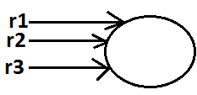
Singleton classes :
For any java class if we are allow to create only one object such type of class is said to be
singleton class.
Example:
1) Runtime class
2) ActionServlet
3) ServiceLocator
4) BusinessDelegate
Runtime r1=Runtime.getRuntime();
//getRuntime() method is a factory method
Runtime r2=Runtime.getRuntime();
Runtime r3=Runtime.getRuntime();
.................................................
.................................................
System.out.println(r1==r2);//true
System.out.println(r1==r3);//true
Advantage of Singleton class :
If the requirement is same then instead of creating a separate object for every person
we will create only one object and we can share that object for every required person we
can achieve this by using singleton classes. That is the main advantages of singleton
classes are Performance will be improved and memory utilization will be improved.
212

Slide 78
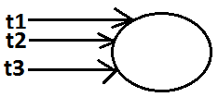
Creation of our own singleton classes
class Client
{
public static void main(String[] args)
{
System.out.println(Test.getTest().hashCode());//1671711
System.out.println(Test.getTest().hashCode());//1671711
System.out.println(Test.getTest().hashCode());//1671711
System.out.println(Test.getTest().hashCode());//1671711
}
}
Diagram:
We can create our own singleton classes for this we have to use private constructor,
static variable and factory method.
Example:
class Test
{
private static Test t=null;
private Test()
{}
public static Test getTest()
//getTest() method is a factory method
{
if(t==null)
{
t=new Test();
}
return t;
}
}
213

Slide 79
else
{
if(Math.random()<0.5) //Math.random() limit : 0<=x<1
return t1;
else
return t2;
}
}
}
class Client
{
public static void main(String[] args)
{
System.out.println(Test.getTest().hashCode());//1671711
System.out.println(Test.getTest().hashCode());//11394033
System.out.println(Test.getTest().hashCode());//11394033
System.out.println(Test.getTest().hashCode());//1671711
}
}
We can create any xxxton classes like(double ton,trible ton...etc)
Example:
class Test
{
private static Test t1=null;
private static Test t2=null;
private Test()
{}
public static Test getTest()
//getTest() method is a factory method
{
if(t1==null)
{
t1=new Test();
return t1;
}
else if(t2==null)
{
t2=new Test();
return t2;
}
213

Slide 80
IIQ : We are not allowed to create child class but class is not final , How it is Possible ?
By declaring every constructor has private.
class Parent {
private Parent() {
}
We can't create child class for this class
Note : When ever we are creating child class object automatically parent class
constructor will be executed but parent object won't be created.
class Parent {
Parent() {
System.out.println(this.hashCode()); //123
}
}
class Child extends Parent {
Child() {
System.out.println(this.hashCode());//123
}
}
class Test {
public static void main(String ar[]) {
Child c=new Child();
System.out.println(c.hashCode());//123
Which of the following is true ?
1. The name of the constructor and name of the class need not be same.(false)
2. We can declare return type for the constructor but it should be void. (false)
3. We can use any modifier for the constructor. (false)
4. Compiler will always generate default constructor. (false)

Slide 81
5. The modifier of the default constructor is always default. (false)
6. The 1st line inside every constructor should be super always. (false)
7. The 1st line inside every constructor should be either super or this and if we are
not writing anything compiler will always place this().(false)
8. Overloading concept is not applicable for constructor. (false)
9. Inheritance and overriding concepts are applicable for constructors. (false)
10. Concrete class can contain constructor but abstract class cannot. (false)
11. Interface can contain constructor. (false)
12. Recursive constructor call is always runtime exception. (false)
13. If Parent class constructor throws some un-checked exception compulsory Child
class constructor should throw the same un-checked exception or it's Parent.
(false)
14. Without using private constructor we can create singleton class. (false)
15. None of the above.(true)
215

Slide 82
Factory method:
By using class name if we are calling a method and that method returns the same class
object such type of method is called factory method.
Example:
Runtime r=Runtime.getRuntime();//getRuntime is a factory method.
DateFormat df=DateFormat.getInstance();
If object creation required under some constraints then we can implement by using
factory method.
215

Slide 83
Static control flow

Slide 84
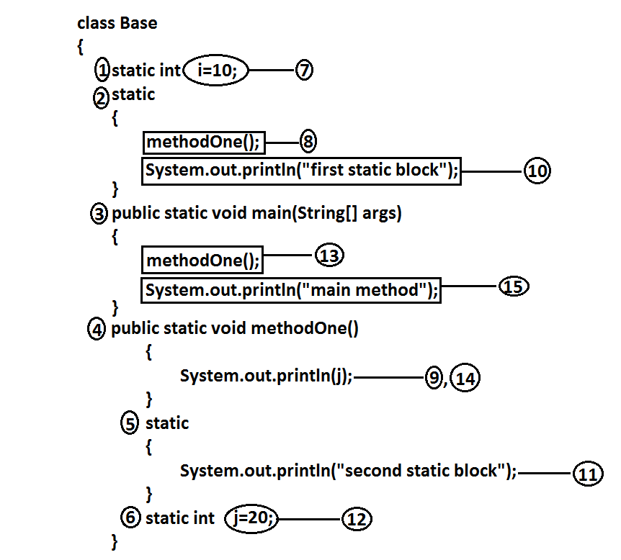
216

Slide 85
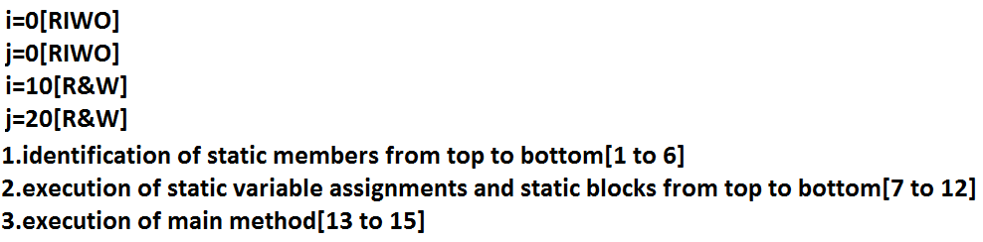
Analysis:
Output:
E:\scjp>javac Base.java
E:\scjp>java Base
0
First static block
Second static block
20
Main method

Slide 86
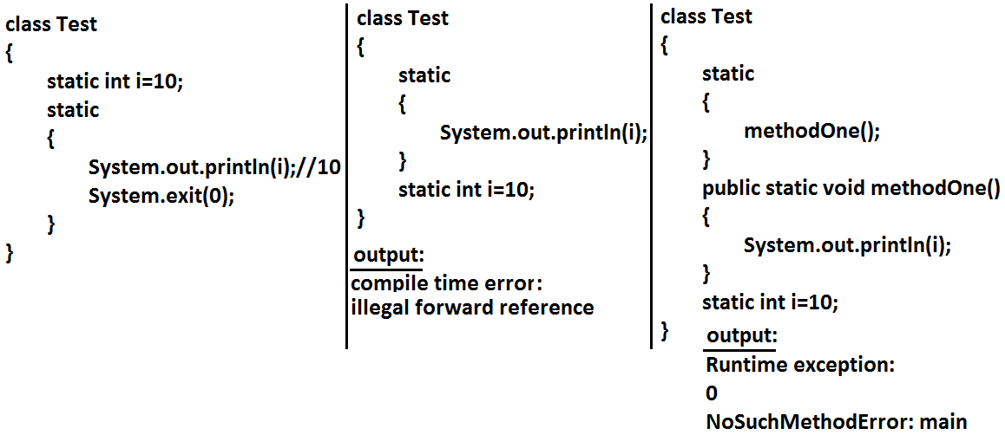
Read indirectly write only state (or) RIWO :
With in the static block if we are trying to read any variable then that read is
considered as "direct read"
If we are calling a method , and with in the method if we are trying to read a method ,
that read is called Indirect read
If a variable is in RIWO state then we can't perform read operation directly otherwise
we will get compile time error saying " illegal forward reference ".
217

Slide 87
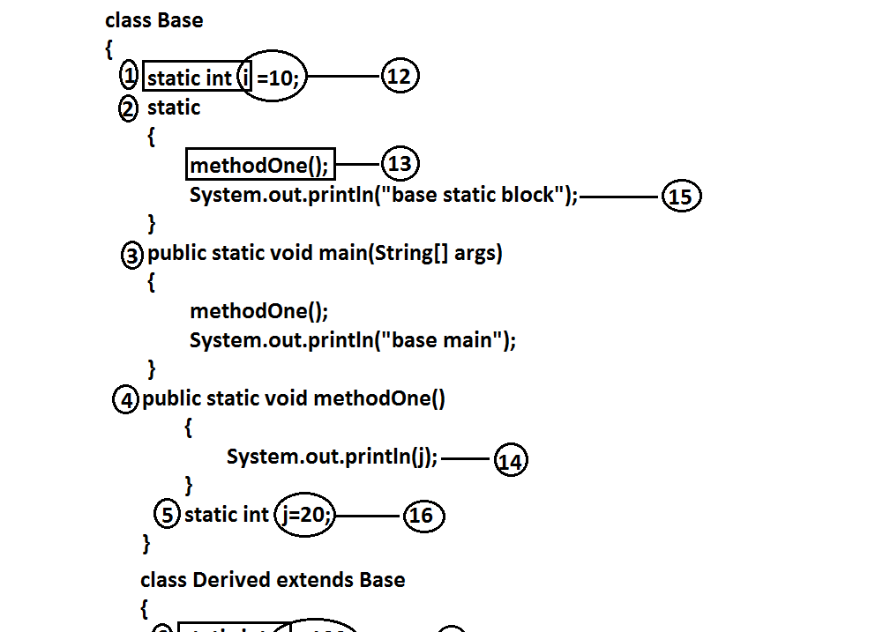
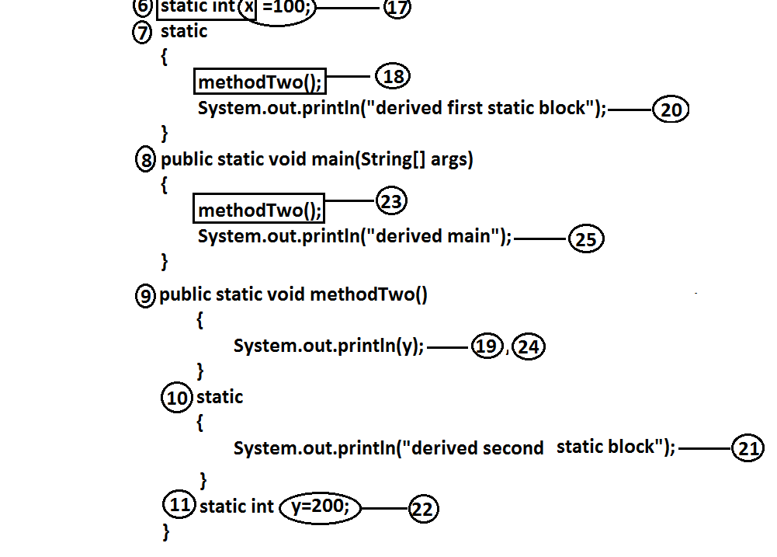
Static control flow parent to child relationship

Slide 88
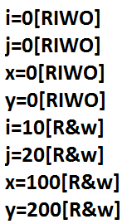
Analysis:
Output:
E:\scjp>java Derived
0
Base static block
0
Derived first static block
Derived second static block
200
Derived main
Output:
E:\scjp>java Base
0
Base static block
20
Basic main

Slide 89
Static block:
• Static blocks will be executed at the time of class loading hence if we want to
perform any activity at the time of class loading we have to define that activity
inside static block.
• With in a class we can take any no. Of static blocks and all these static blocks will
be executed from top to bottom.
Whenever we are executing Child class the following sequence of events will be
performed automatically.
1. Identification of static members from Parent to Child. [1 to 11]
2. Execution of static variable assignments and static blocks from Parent to
Child.[12 to 22]
3. Execution of Child class main() method.[23 to 25].
Note : When ever we are loading child class autimatically the parent class will be loaded
but when ever we are loading parent class the child class don't be loaded automatically
Example:
The native libraries should be loaded at the time of class loading hence we have to define that activity inside static block.
Example:
class Test
{
static
{
System.loadLibrary("native library path");
}
}
219

Slide 90
Example:
class Google
{
static
{
System.out.println("hello i can print");
System.exit(0);
}
}
Output:
Hello i can print
Ex 2 : Every JDBC driver class internally contains a static block to register the driver with DriverManager hence programmer is not responsible to define this explicitly.
Example:
class Driver
{
static
{
//Register this driver with DriverManager
}
}
IIQ : Without using main() method and static block is it possible to print some
statements to the console ?
IIQ : Without using main() method is it possible to print some statements to the
console?
Ans : Yes, by using static block.
Example 1:
class Test
{
static int i=methodOne();
public static int methodOne()
{

Slide 91
Example 3:
class Test
{
static Test t=new Test();
{
System.out.println("hello i can print");
System.exit(0);
}
}
Output:
Hello i can print
System.out.println("hello i can print");
System.exit(0);
return 10;
}
}
Output:
Hello i can print
Example 2:
class Test
{
static Test t=new Test();
Test()
{
System.out.println("hello i can print");
System.exit(0);
}
}
Output:
Hello i can print
IIQ : Without using System.out.println() statement is it possible to print some statement to the console ?
Example:
class Test
{
public static void main(String[] args)
{
System.err.println("hello");
}
}

Slide 92
Note : Without using main() method we can able to print some statement to the sonsole , but this rule is applicable untill 1.6 version from 1.7 version onwards to run java program main() method is mandatory.
class Test {
static {
System.out.println("ststic block");
System.exit(0);
}
}
It is valid in 1.6 version but invalid or won't run in 1.7 version

Slide 93
Instance control flow:

Slide 94
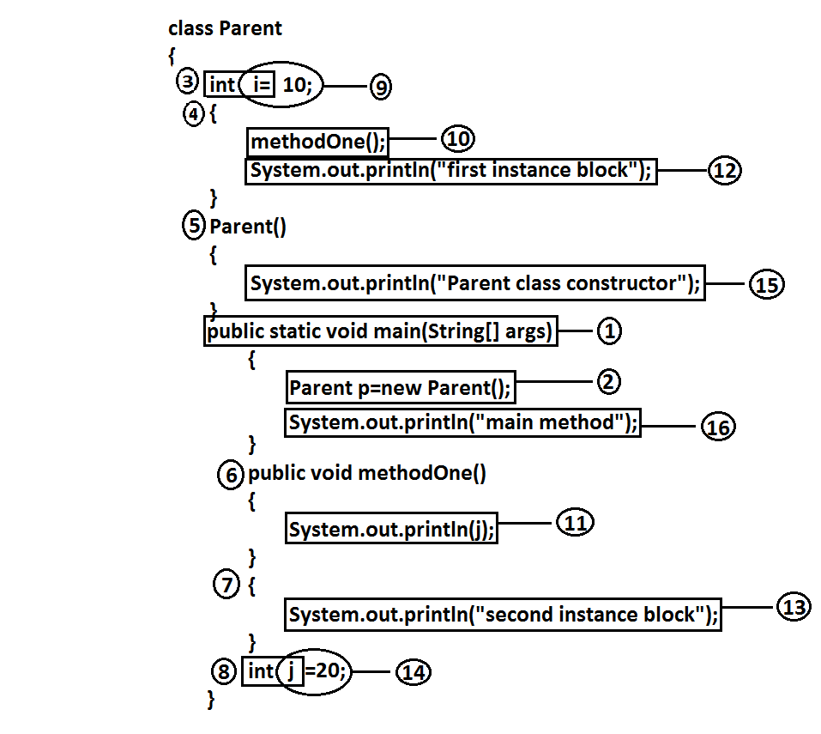
222

Slide 95
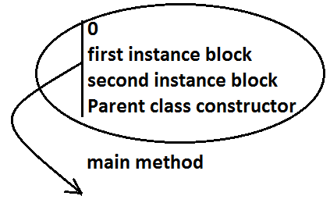
Analysis:
i=0[RIWO]
j=0[RIWO]
i=10[R&W]
j=20[R&W]
Whenever we are executing a java class static control flow will be executed. In the Static
control flow Whenever we are creating an object the following sequence of events will be performed automatically.
1. Identification of instance members from top to bottom(3 to 8).
2. Execution of instance variable assignments and instance blocks from top to
bottom(9 to 14).
3. Execution of constructor.
Output:
Note: static control flow is one time activity and it will be executed at the time of class
loading.
But instance control flow is not one time activity for every object creation it will be
executed
223

Slide 96
Instance control flow in Parent to Child relationship :
Example:
class Parent
{
int x=10;
{
methodOne();
System.out.println("Parent first instance block");
}
Parent()
{
System.out.println("parent class constructor");
}
public static void main(String[] args)
{
Parent p=new Parent();
System.out.println("parent class main method");
}
public void methodOne()
{
System.out.println(y);
}
int y=20;
}
class Child extends Parent
{
int i=100;
{
methodTwo();
System.out.println("Child first instance block");
}
Child()
{
System.out.println("Child class constructor");
}
public static void main(String[] args)
{
Child c=new Child();
System.out.println("Child class main method");
}
223

Slide 97
Whenever we are creating child class object the following sequence of events will be
executed automatically.
1. Identification of instance members from Parent to Child.
2. Execution of instance variable assignments and instance block only in Parent
class.
3. Execution of Parent class constructor.
4. Execution of instance variable assignments and instance blocks in Child class.
5. Execution of Child class constructor.
public void methodTwo()
{
System.out.println(j);
}
{
System.out.println("Child second instance block");
}
int j=200;
}
Output:
E:\scjp>javac Child.java
E:\scjp>java Child
0
Parent first instance block
Parent class constructor
0
Child first instance block
Child second instance block
Child class constructor
Child class main method
Note: Object creation is the most costly operation in java and hence if there is no specific requirement never recommended to crate objects.

Slide 98

Analysis
Example 1:
public class Initilization
{
private static String methodOne(String msg) //-->1
{
System.out.println(msg);
return msg;
}
public Initilization() //-->4
{
m=methodOne("1"); //-->9
}
{ //-->5
m=methodOne("2"); //-->7
}
String m=methodOne("3"); //-->6 , //-->8
public static void main(String[] args) //-->2
{
Object obj=new Initilization(); //-->3
}
}
Output:
2
3
1
224

Slide 99
Example 2:
public class Initilization
{
private static String methodOne(String msg) //-->1
{
System.out.println(msg);
return msg;
}
static String m=methodOne("1"); //-->2, //-->5
{
m=methodOne("2");
}
static //-->3
{
m=methodOne("3"); //-->6
}
public static void main(String[] args) //-->4
{
Object obj=new Initilization();
}
}
Output:
1
3
2
We can't access instance variables directly from static area because at the time of execution of static area JVM may not identify those members.
225

Slide 100

• But from the instance area we can access instance members directly.
• Static members we can access from anywhere directly because these are identified already at the time of class loading only.

Slide 101
Type casting

Slide 102

Parent class reference can be used to hold Child class object but by using that reference
we can't call Child specific methods.
Example:
Object o=new String("ashok");//valid
System.out.println(o.hashCode());//valid
System.out.println(o.length());//
C.E:cannot find symbol,
symbol : method length(),
location: class java.lang.Object
Similarly we can use interface reference to hold implemented class object.
Example:
Runnable r=new Thread();
Type casting syntax:

Slide 103


Compile time checking
Rule 1: The type of "d" and "c" must have some relationship [either Child to Parent
(or) Parent to Child (or) same type] otherwise we will get compile time error saying inconvertible types
Example 2:
Example 1:

Slide 104


Rule 2: "C" must be either same (or) derived type of "A" otherwise we will get compile
time error saying incompatible types.
Found: C
Required: A
Example 1:
Example 2:
227

Slide 105

Runtime checking :
The underlying object type of "d" must be either same (or) derived type of "C"
otherwise we will get runtime exception saying ClassCastException.
Example:
228

Slide 106

Base1 b=new Derived2();//valid
Object o=(Base1)b;//valid
Object o1=(Base2)o;//invalid
Object o2=(Base2)b;//invalid
Base2 b1=(Base1)(new Derived1());//invalid
Base2 b2=(Base2)(new Derived3());//valid
Base2 b2=(Base2)(new Derived1());//invalid
229

Slide 107

Through Type Casting just we are converting the type of object but not object itself that
is we are performing type casting but not object casting.
Through Type Casting we are not create any new objects, for the existing objects we are
providing another type of reference variable(mostly Parent type).
229

Slide 108


230

Slide 109

It is overriding and method resolution is based on runtime object.
C c=new C();
c.methodOne();//c
((B)c).methodOne();//c
((A)((B)c)).methodOne();//c
231

Slide 110

It is method hiding and method resolution is based on reference type.
C c=new C();
c.methodOne();//C
((B)c).methodOne();//B
((A)((B)c)).methodOne();//A

Slide 111

C c=new C();
System.out.println(c.x);//999
System.out.println(((B)c).x);//888
System.out.println(((A)((B)c)).x);//777
• Variable resolution is always based on reference type only.
• If we are changing variable as static then also we will get the same output.
232

Slide 112
Type casting

Slide 113
The degree of dependency between the components is called coupling.
Example:
class A
{
static int i=B.j;
}
class B extends A
{
static int j=C.methodOne();
}
class C extends B
{
public static int methodOne()
{
return D.k;
}
}
class D extends C
{
static int k=10;
public static void main(String[] args)
{
D d=new D();
}
}
The above components are said to be tightly coupled to each other because the
dependency between the components is more.
Tightly coupling is not a good programming practice because it has several serious
disadvantages.
1. Without effecting remaining components we can't modify any component hence
enhancement(development) will become difficult.
2. It reduces maintainability of the application.
3. It doesn't promote reusability of the code.
It is always recommended to maintain loosely coupling between the components
233

Slide 114
Cohesion

Slide 115

For every component we have to maintain a clear well defined functionality such type of
component is said to be follow high cohesion.
234

Slide 116
High cohesion is always good programming practice because it has several advantages.
Without effecting remaining components we can modify any component hence enhancement will become very easy.
2. It improves maintainability of the application.
3. It promotes reusability of the application.(where ever validation is required we
can reuse the same validate servlet without rewriting )
Note: It is highly recommended to follow loosely coupling and high cohesion.
234

Slide 117
Thank you

